Slide 1
HYDXPLORE
BY
DEVI ABHIGNA (1601-18-737-002)
SATHVIKA PATWARI (1601-18-737-016)

Slide 2
HYDXPLORE
INTRODUCTION
Hydxplore is a web application which is mainly aimed to produce a tourist guide for Hyderabad City.
Tourists get a detailed information regarding the places located in Hyderabad along with the directions.
This web application has been developed using HTML, CSS ,JavaScript ,PHP and MySql.

Slide 3
MOTIVATION
The idea of this project was obtained after going through all the tourism websites, where we got to know the problems facing by the tourists.
Keeping this in mind we came with the solution and developed this project.
The web application Hydxplore guide the tourist who visits Hyderabad. It gives a clear information about the historic places, museums, amusement parks, shopping malls etc., and also provides the directions for your selected destination.

Slide 4
PROBLEM STATEMENT
The scope of this project is to provide an easy way to explore the city “Hyderabad” and resolve the problems faced by the tourists.
It saves the time of the tourists because all the information regarding the directions, locations and nearby places are provided in this website.
This application can be accessed by any person who has internet connection at any time day or night. There will be no payment requirements to use this application.

Slide 5
EXISTING SYSTEM
In the existing system, all the tourism websites are just for profits.
They just see to their profits by doing activities such as increasing the cost of the hotel room, suggesting guides and demanding more money for them etc.
These kind of activities really trouble the tourists.

Slide 6
PROPOSED SYSTEM
METHODOLOGY
In the proposed system, Hydxplore provides an easier way to the users in searching a place, directions, getting textual and pictorial information of the place you search in a single application for free of cost.
The users get all the details of the places and their directions in a single click.
They should just open the application and register by giving details like name, email-id and password. Once registered you can login in anytime, anywhere.

Slide 7
Architecture Of Proposed System
The user needs to follow the following steps:
In the Main page, Click on login box.
As soon as you click on the login button, a login form appears in which you need to fill your details and click on submit.
If you are a new user, you need to register and then login.
As you are logged in, you can search for the required places.
After finding the required information, you need to logout.

Slide 8
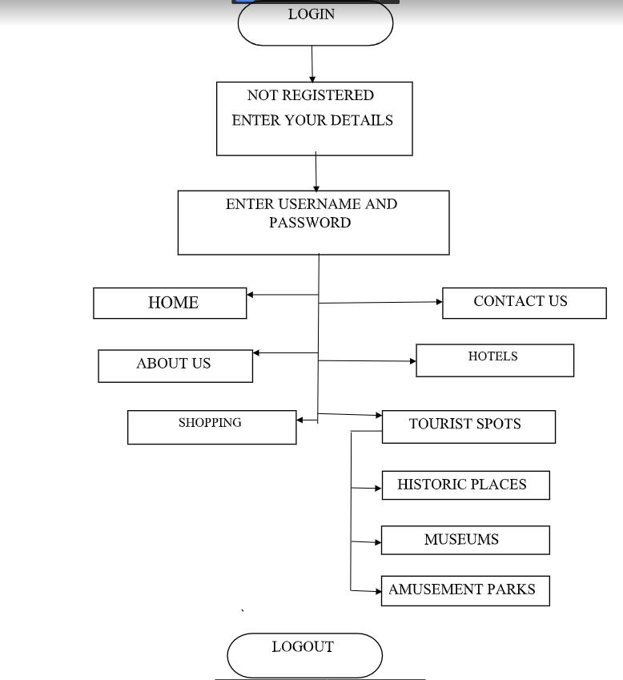
Flow chart of Architecture Of Proposed System

Slide 9
SOFTWARE AND HARDWARE REQUIREMENTS
Operating System : Windows 10
Programming Languages: Front End: HTML, CSS, JavaScript, PHP
Back End: MySql
Other Applications : Notepad / Sublime text
Processor : Intell core i5-4300 CPU @ 1.90GHz 2.49GHz
RAM: 4GB or more
Disk Space: 10GB or more

Slide 10
IMPLEMENTATION OF PROJECT
In this project, there are different stages – planning, design, coding and testing. The objective is to completely finish each logical step in the development process before moving onto the next.
Modifications can be made if necessary.

Slide 11
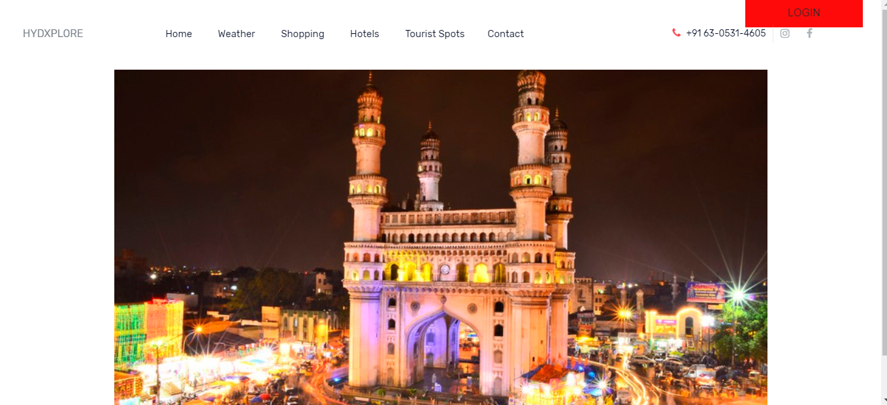
MAIN PAGE

Slide 12
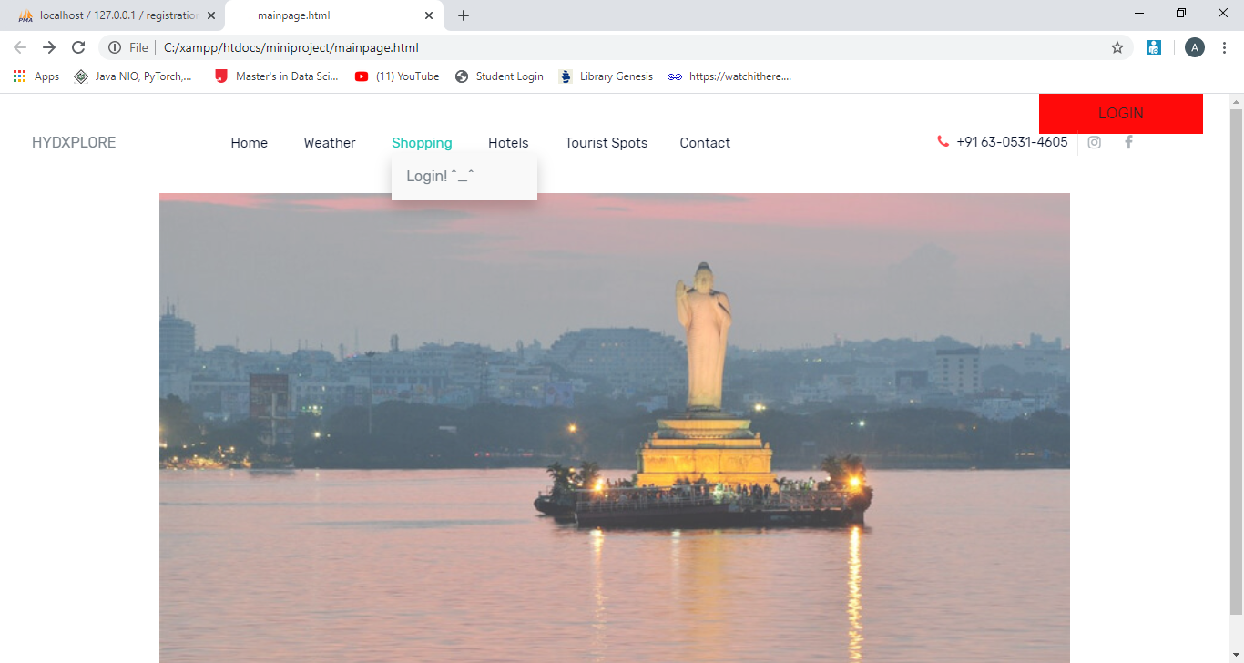
MAIN PAGE BEFORE LOGGING IN

Slide 13
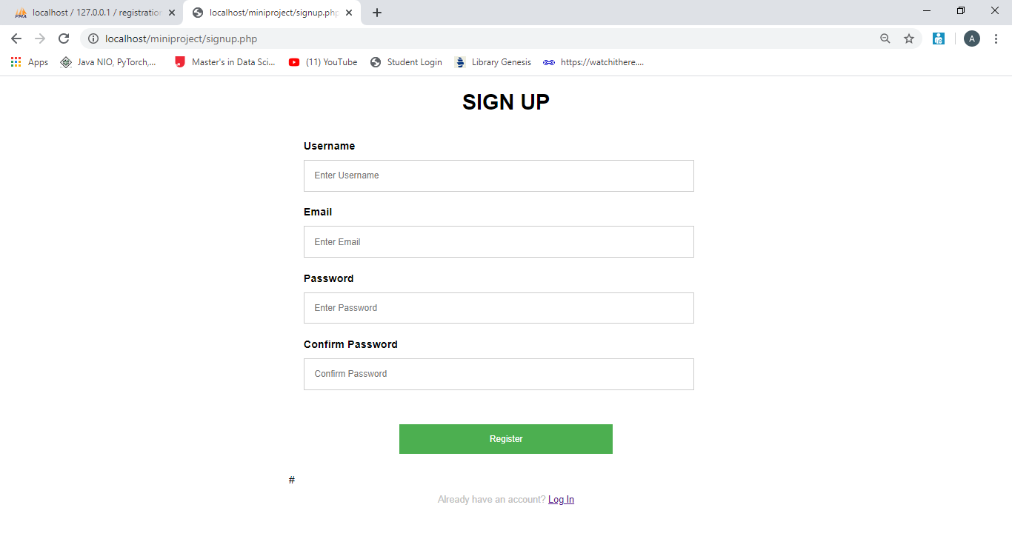
SIGNUP FORM

Slide 14
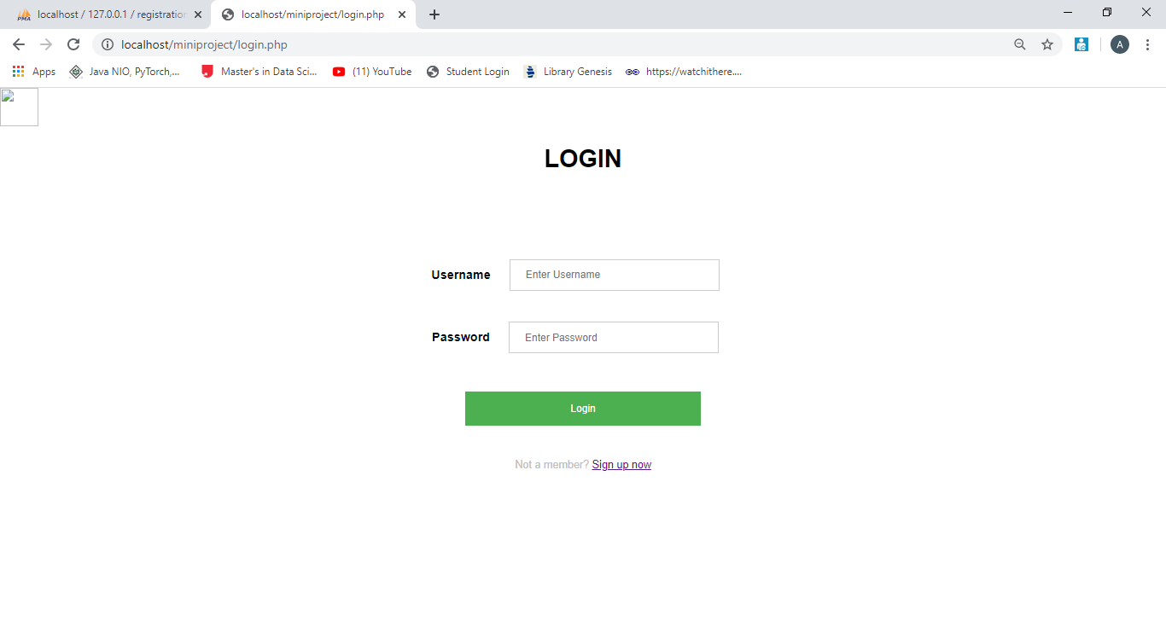
LOGIN

Slide 15
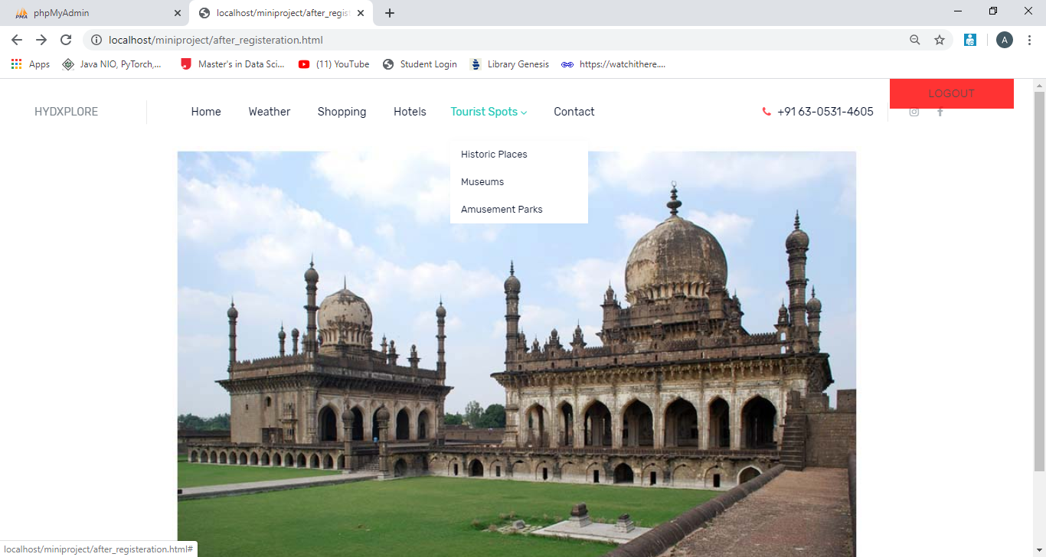
HOMEPAGE AFTER YOU LOGIN

Slide 16
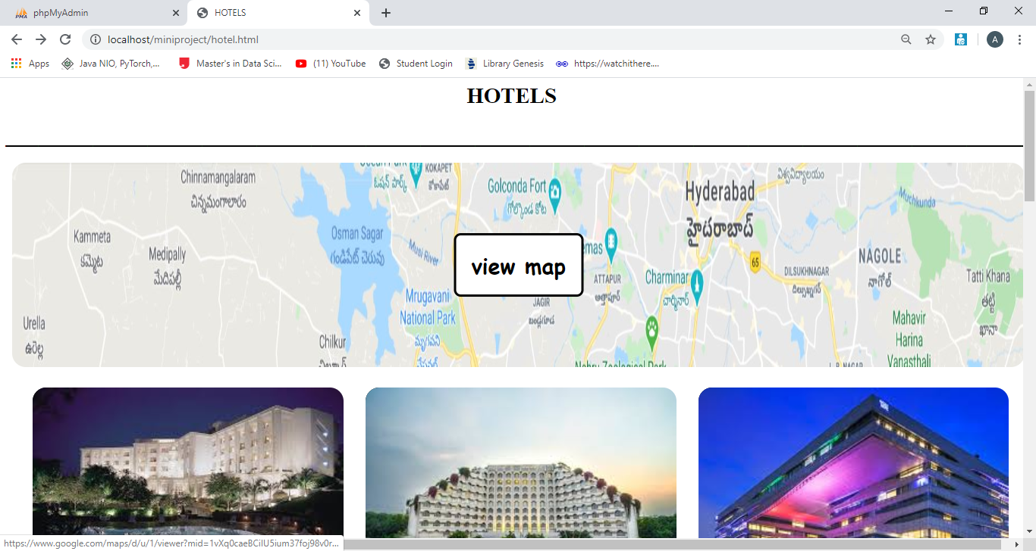
HOTELS

Slide 17
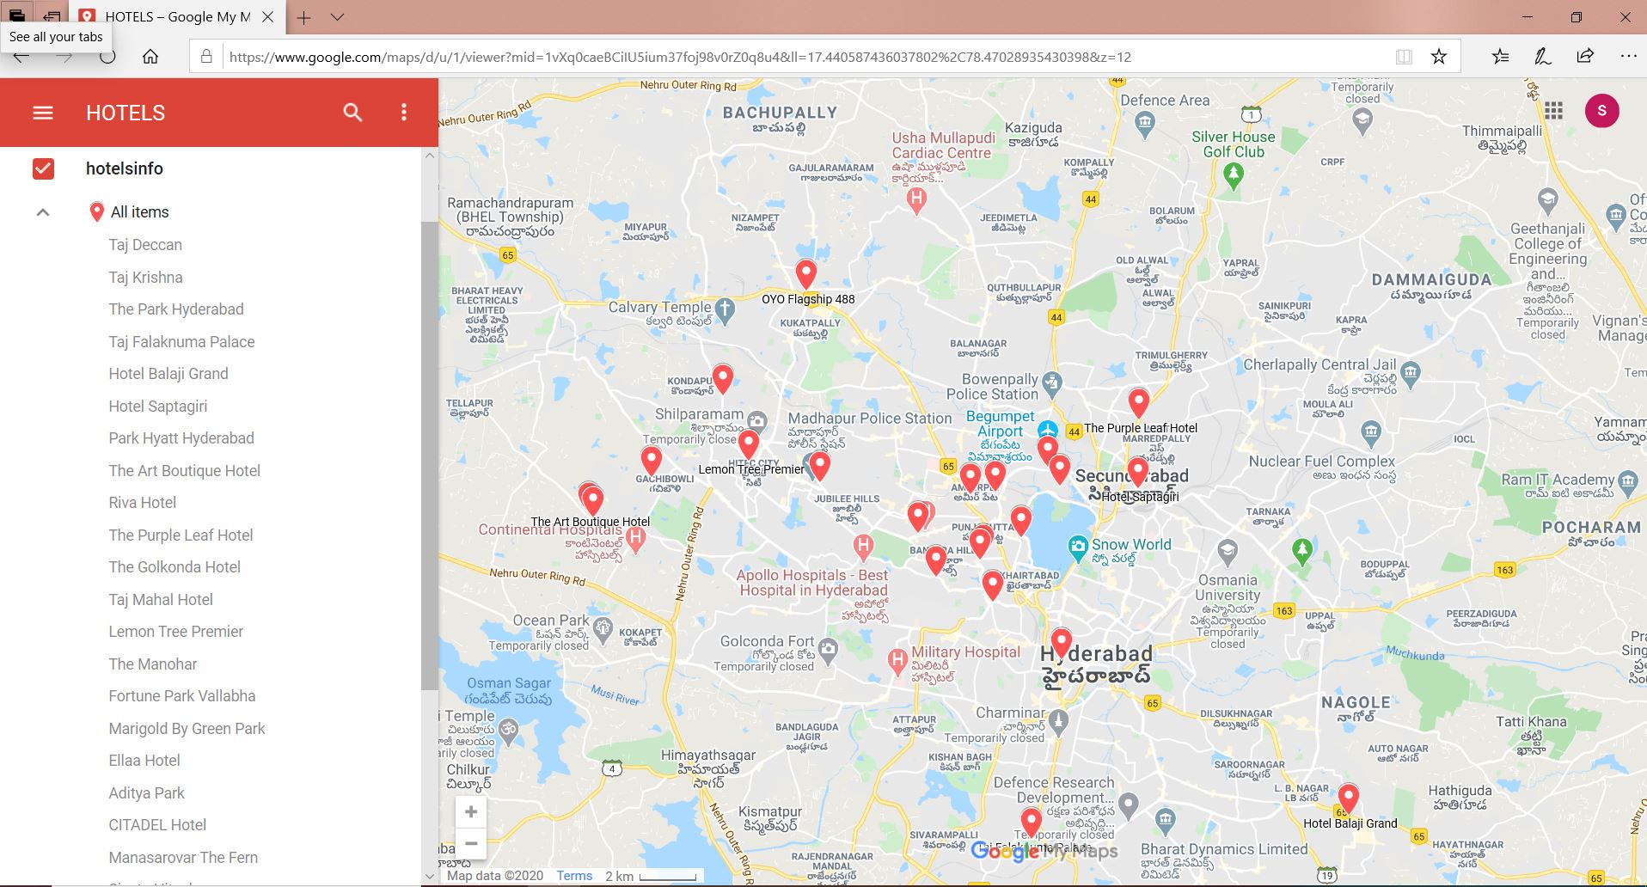

Slide 18
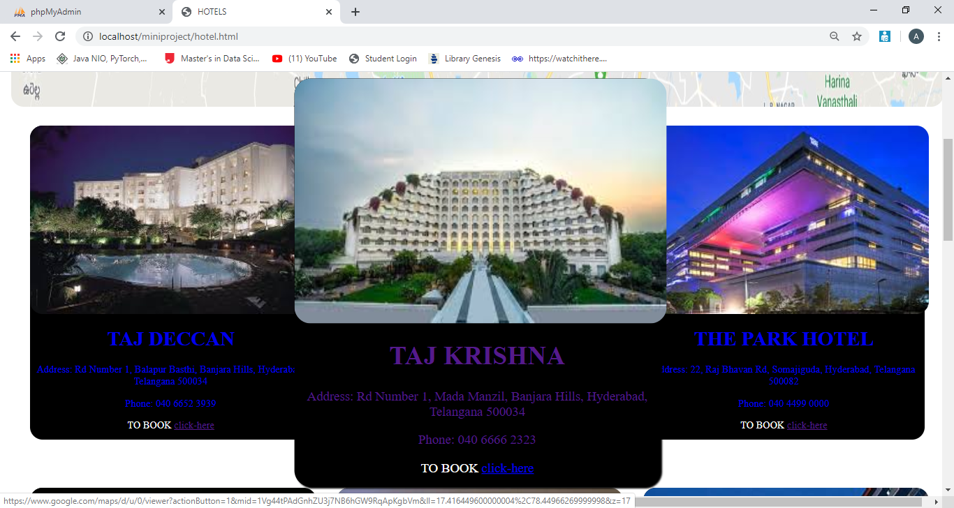

Slide 19
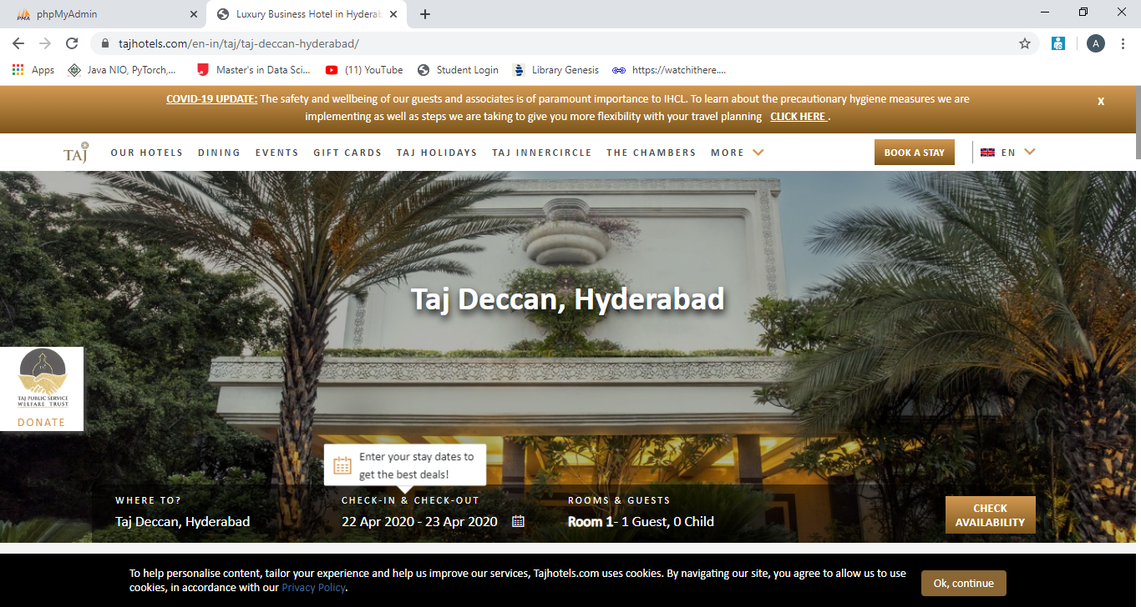
BOOK NOW

Slide 20
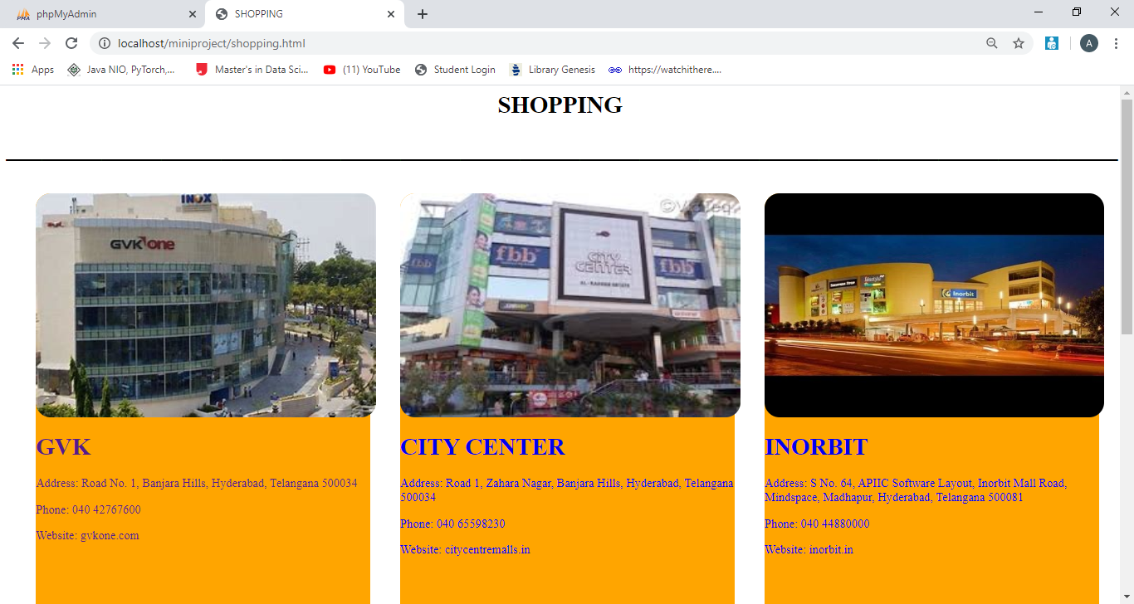
SHOPPING

Slide 21
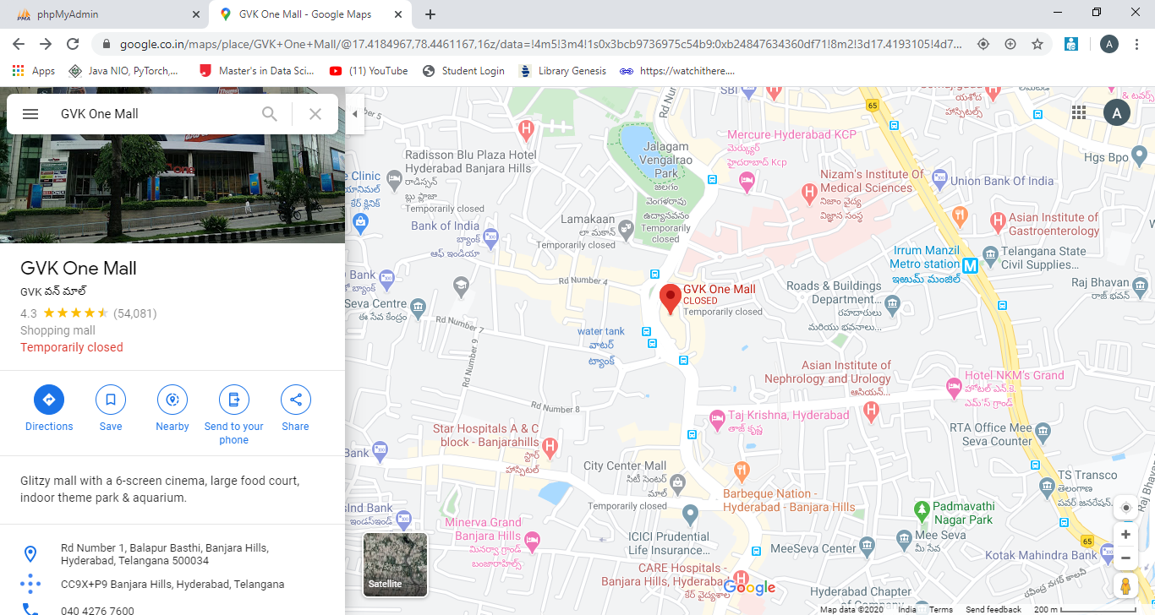
DIRECTIONS

Slide 22
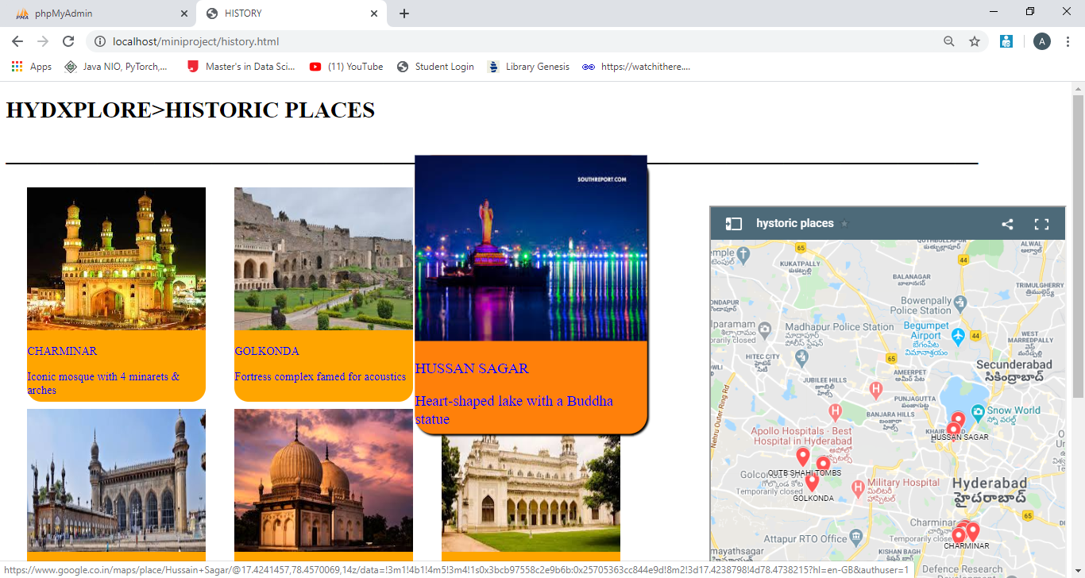
HISTORIC PLACES

Slide 23
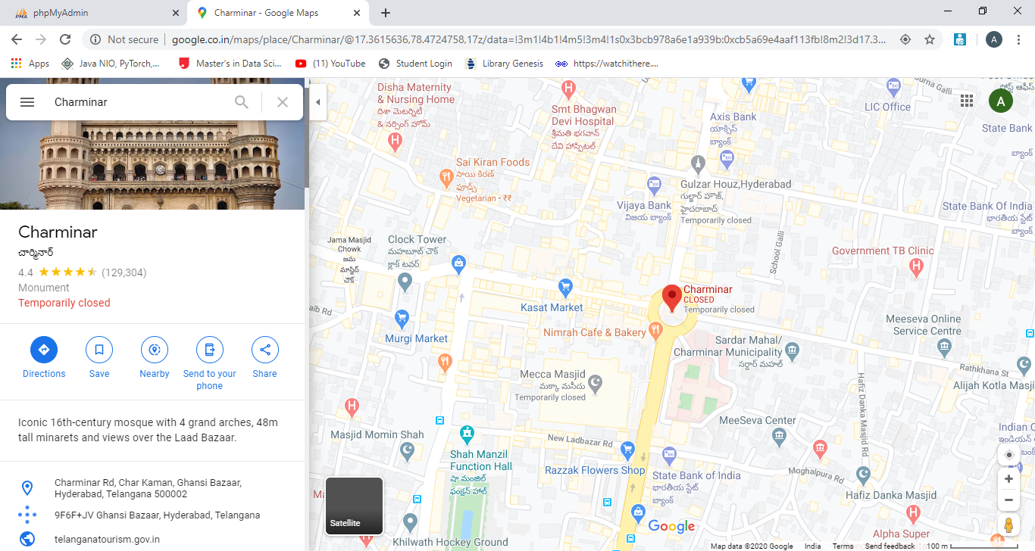

Slide 24
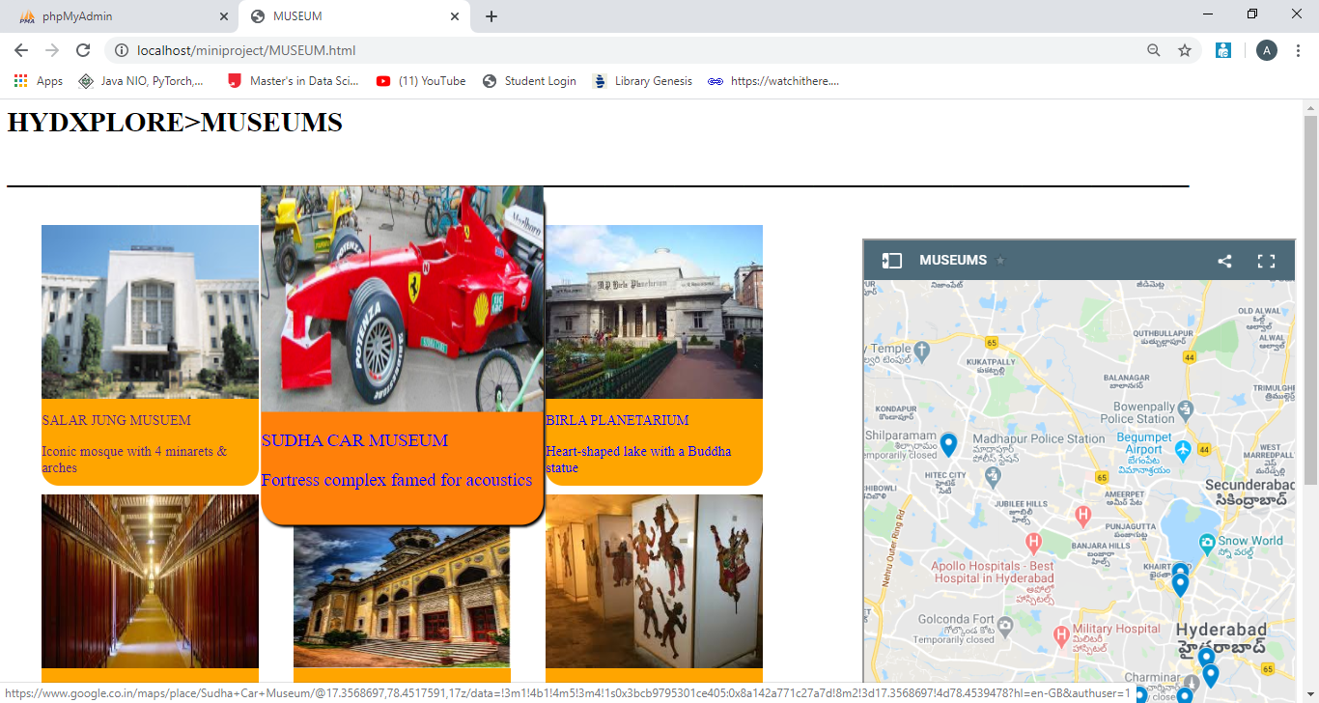
MUSEUMS

Slide 25
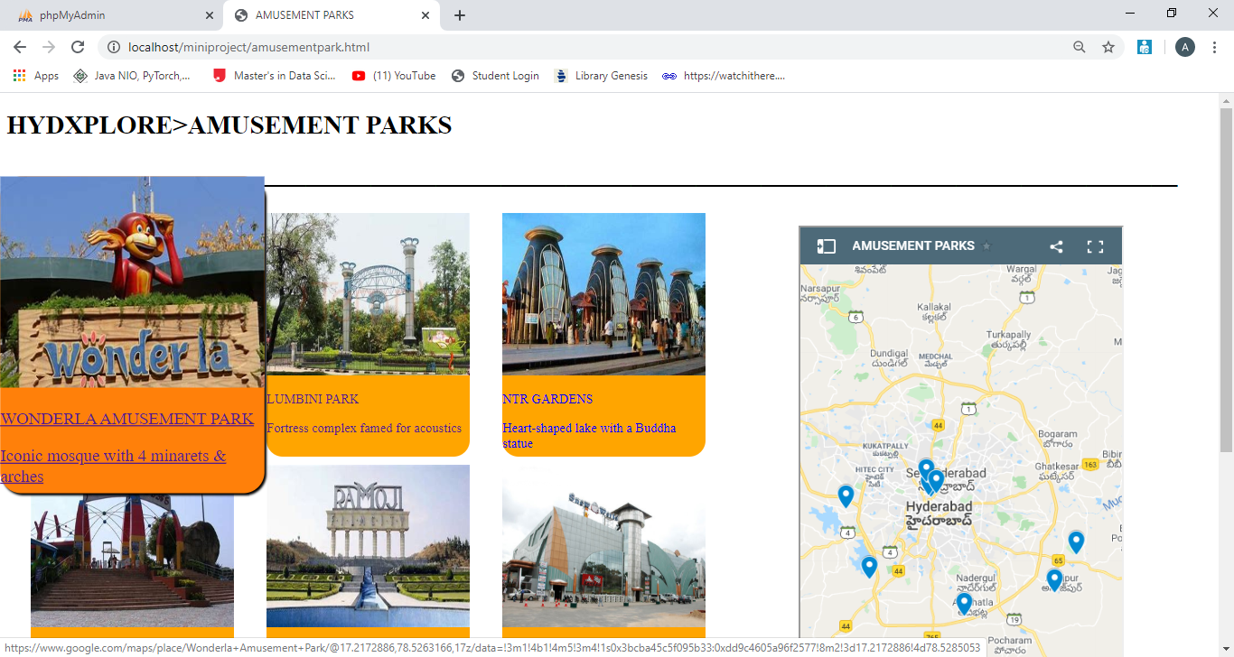
AMUSEMENT PARKS

Slide 26
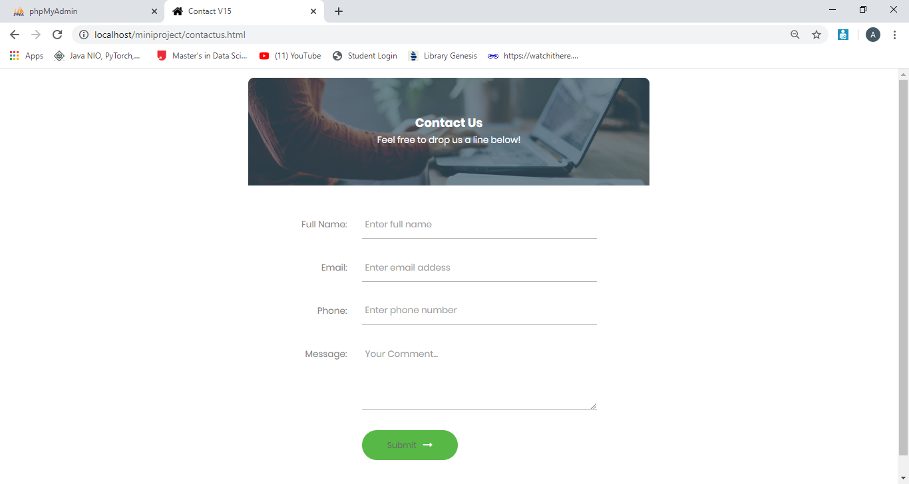
CONTACT US

Slide 27
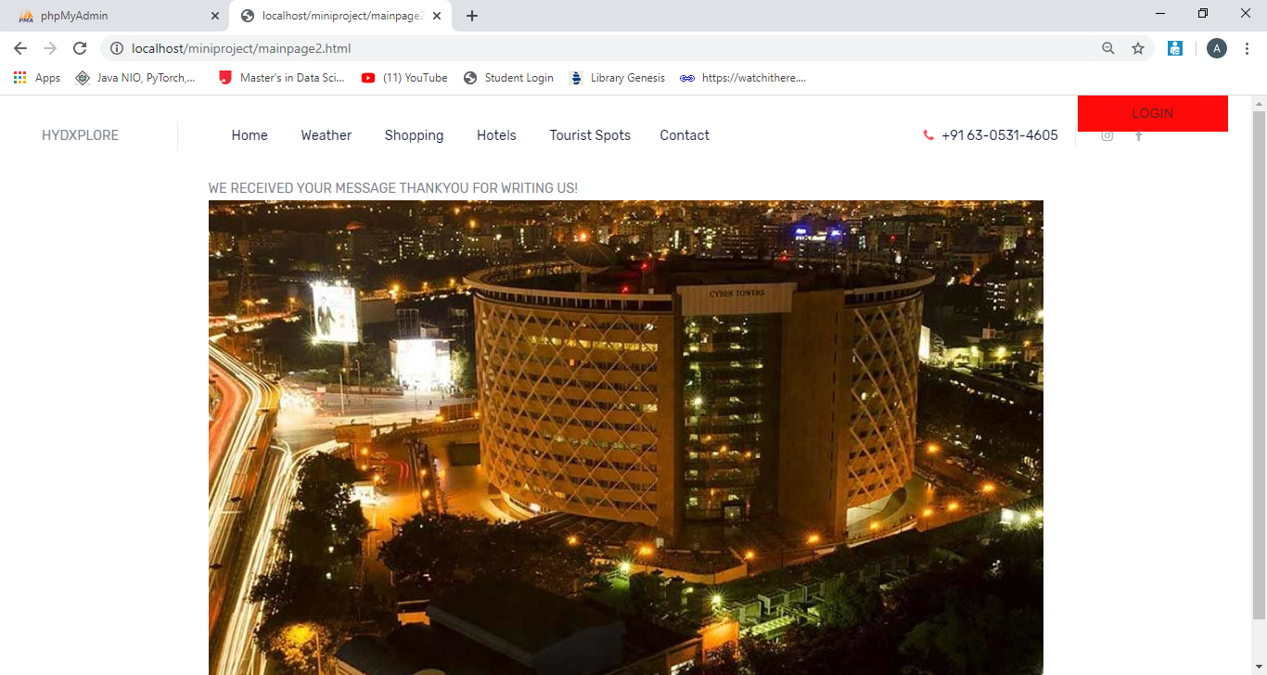

Slide 28
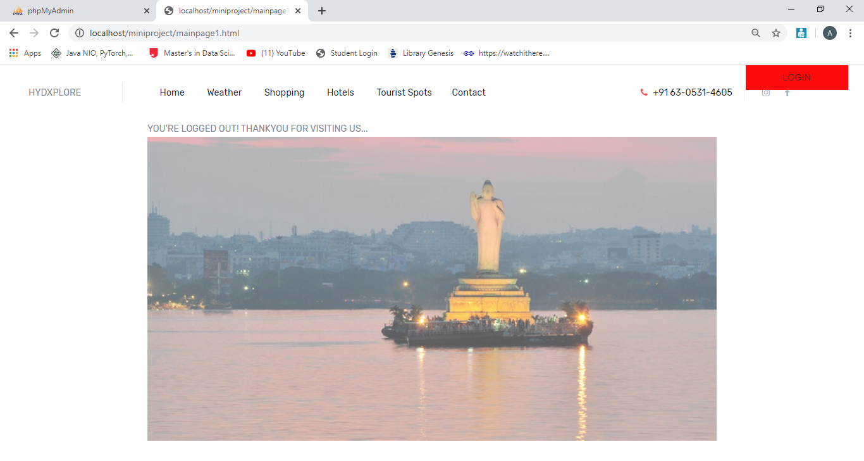
AFTER LOGGED OUT

Slide 29
CONCLUSION & FUTURE SCOPE
The web application Hydxplore can be very helpful for every person who is new to Hyderabad. With this platform, the web application Hydxplore is developed, hoping to reduce time wastage, avoid misunderstandings, provide easy data flow, customer pleasure, and less hard work.
There is always scope for improvement and that is the case with our project as well. In the future few more features can be added to the website such as
Creating a mobile app.
Adding more attractive styles to make the overall website appealing to the users.

Slide 30
THANK YOU

